Slide 1
APPS FOR LEARNING ENGLISH
Teacher Daniela Clavijo Rivera
Bilingual Program
May 2023

Slide 2
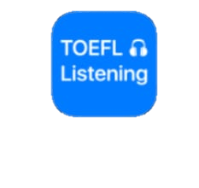
CONTENTS
APPS FOR LEARNING ENGLISH
2.
5.
6.

Slide 3
APPS FOR LEARNING ENGLISH
PRIMARY EDUCATION | LOWER SECUNDARY EDUCATION | UPER SECUNDARY EDUCATION
X | X | X
App has different levels (it asks about your own English knowledge)
Each level has sections for advancing in the game.

Slide 4
APPS FOR LEARNING ENGLISH
Each section presents four skills: reading, speaking, writing and listening.
It´s a funny way for learning vocabulary and grammar.

Slide 5
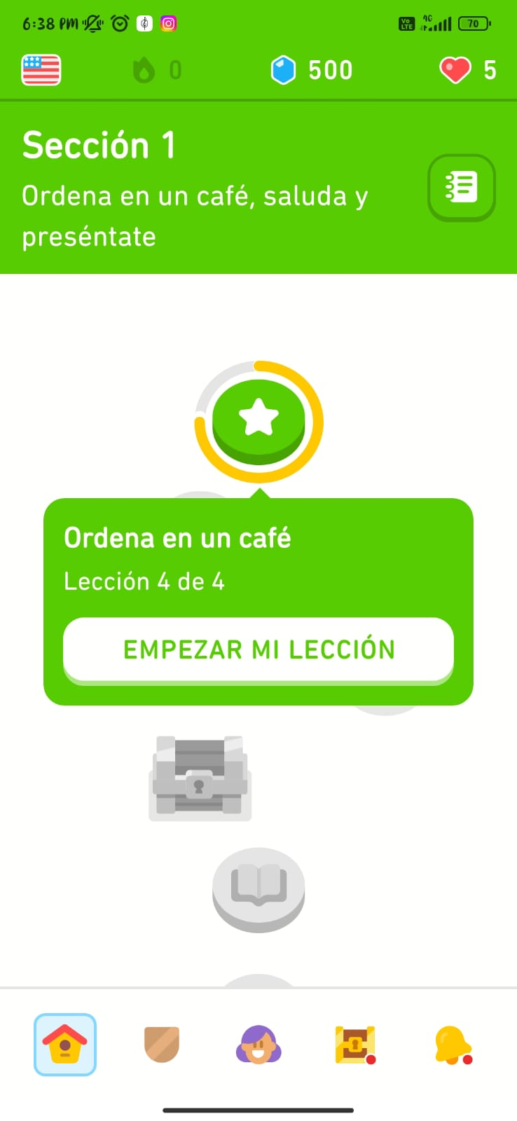
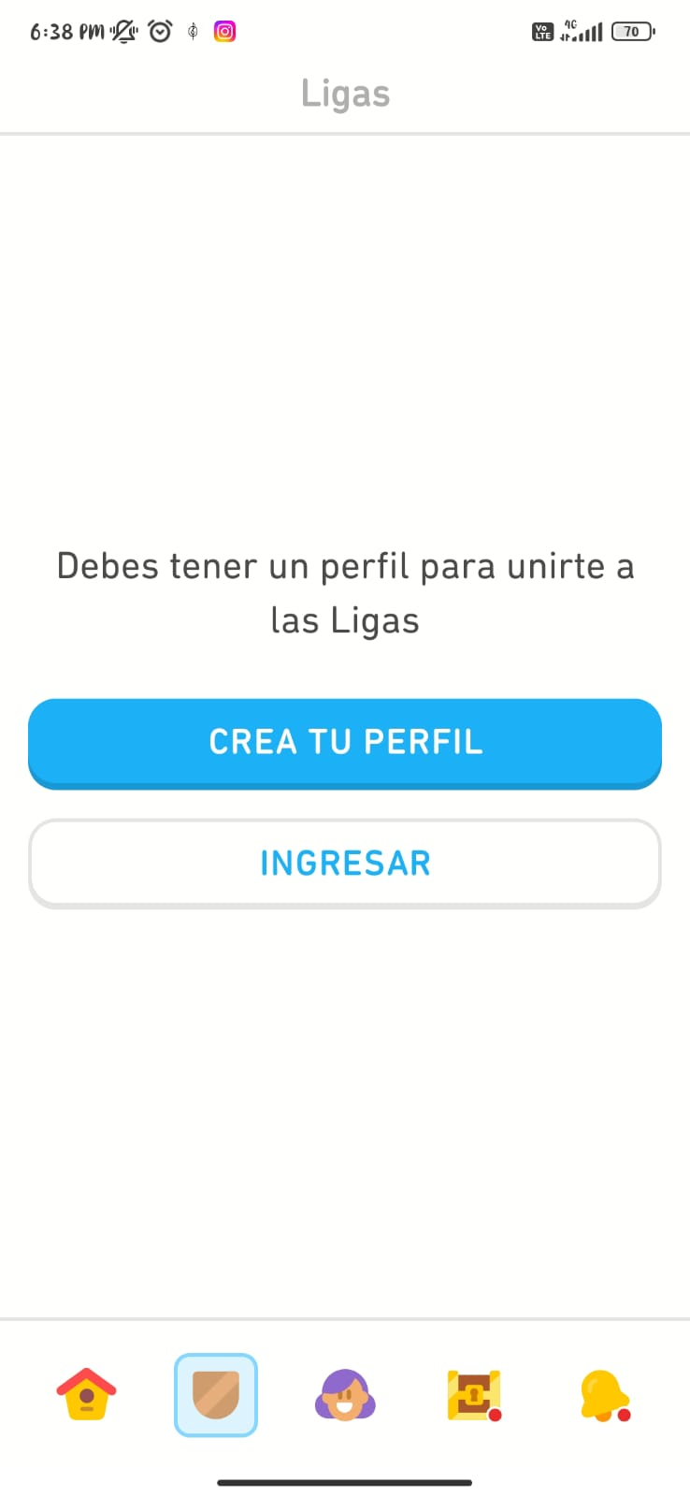
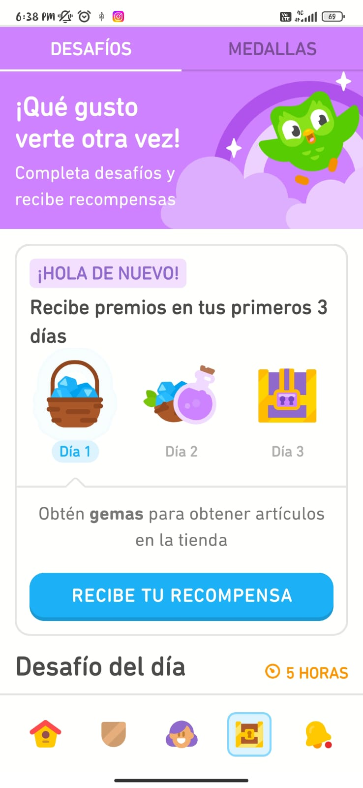
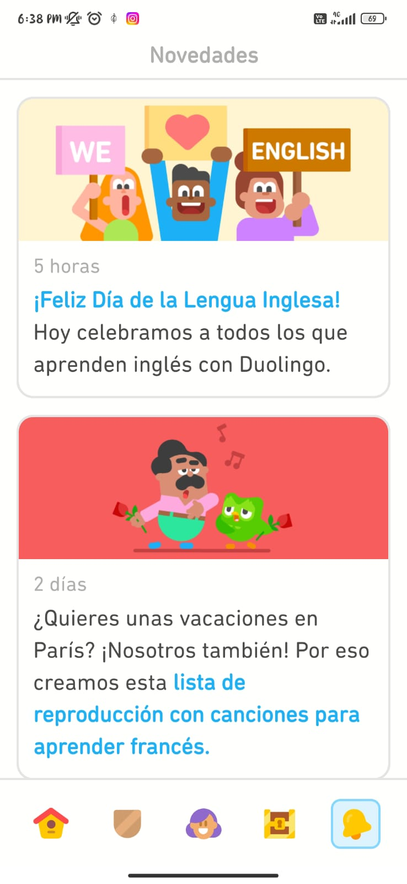
APPS FOR LEARNING ENGLISH

Slide 6
APPS FOR LEARNING ENGLISH
https://play.google.com/store/apps/details?id=com.duolingo
For enjoying the app is necessary
Internet
Email account (Gmail for getting in Play store)
Stay with an adult while you play in the app

Slide 7
APPS FOR LEARNING ENGLISH
BÁSICA PRIMARIA | BÁSICA SECUNDARIA | EDUCACIÓN MEDIA
 | X | X
App reinforce four skills: listening, reading, speaking and vocabulary.
Toelf has different activities and exams for reviewing four skills. Teachers can take advantage of those for their classes.

Slide 8
APPS FOR LEARNING ENGLISH
Readings and audios contextualize different situations.
The app has downable material for playing offline
In pronunciation section you can get phonics of the words, also it present a link with YouTube for listening the pronunciation.

Slide 9
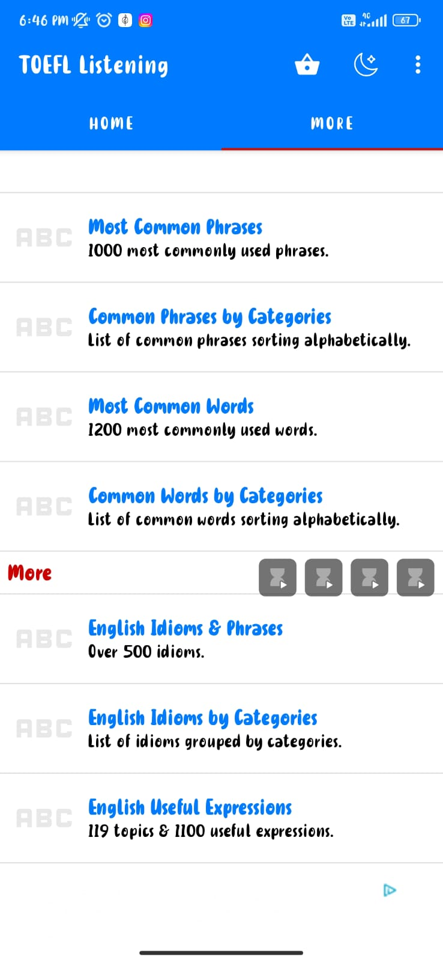
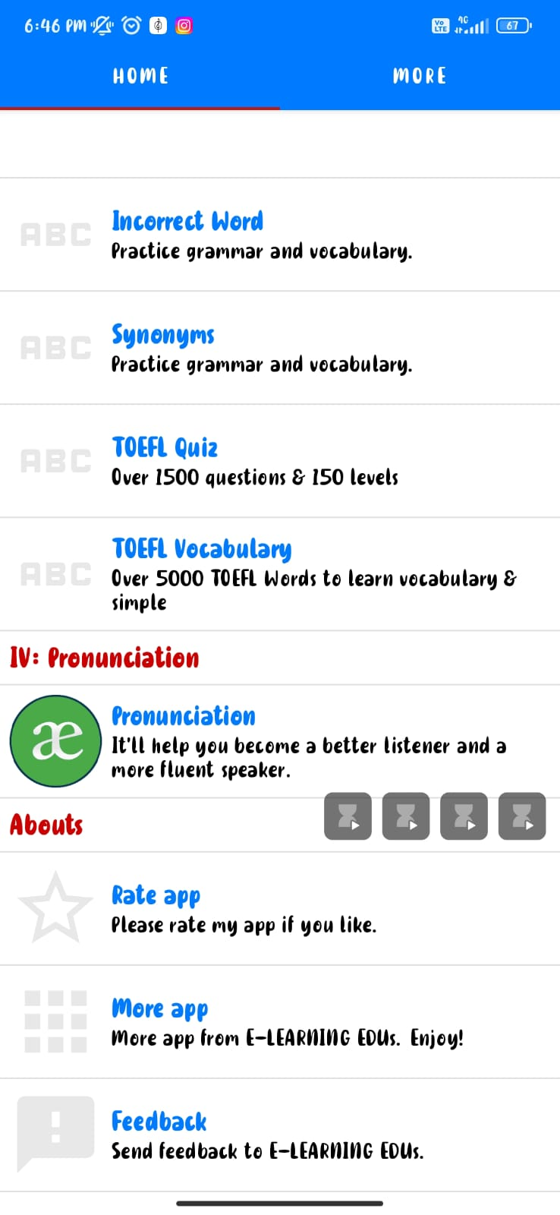
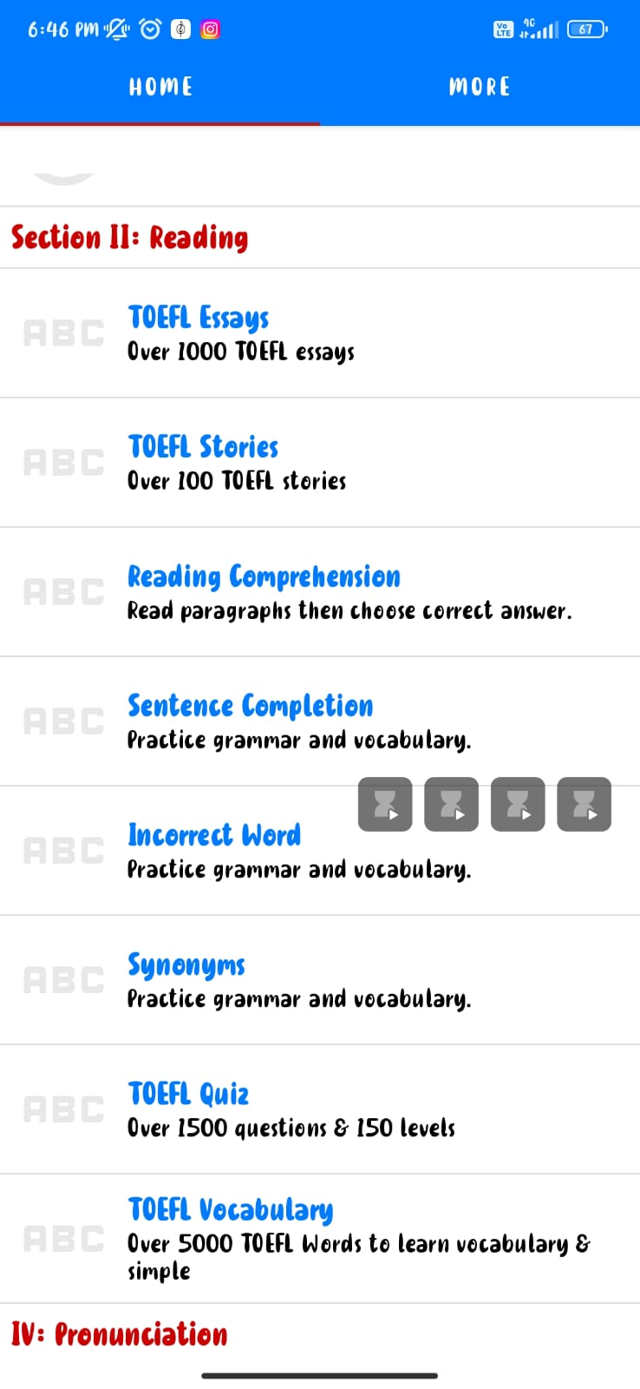
APPS FOR LEARNING ENGLISH

Slide 10
APPS FOR LEARNING ENGLISH
https://play.google.com/store/apps/details?id=com.elearning.toefl
For enjoying the app is necessary
Internet
Email account (Gmail for getting in Play store)
Stay with an adult while you play in the app

Slide 11
APPS FOR LEARNING ENGLISH
BÁSICA PRIMARIA | BÁSICA SECUNDARIA | EDUCACIÓN MEDIA
x | x | x
Different activities reinforce four skills: listening, writing, Reading and speaking.
Learning is contextualized by movie scenes.

Slide 12
APPS FOR LEARNING ENGLISH
Path button for play different levels.
Classes button has material for learning.
You can find a study button: classes, vocabulary and expressions.
App presents different tests for applying knowledge.

Slide 13
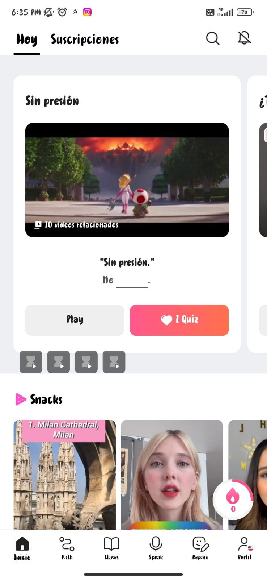
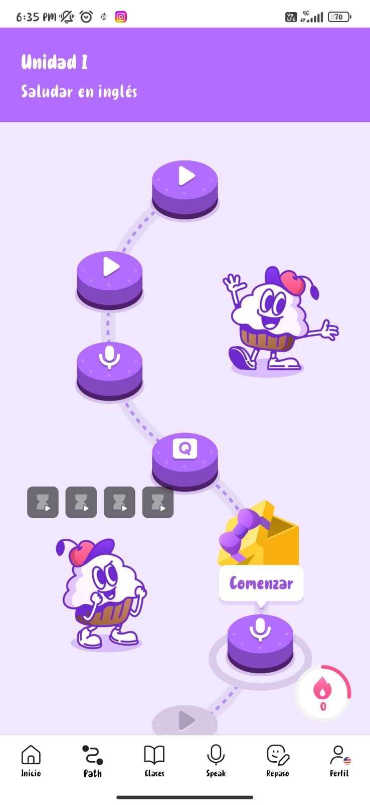
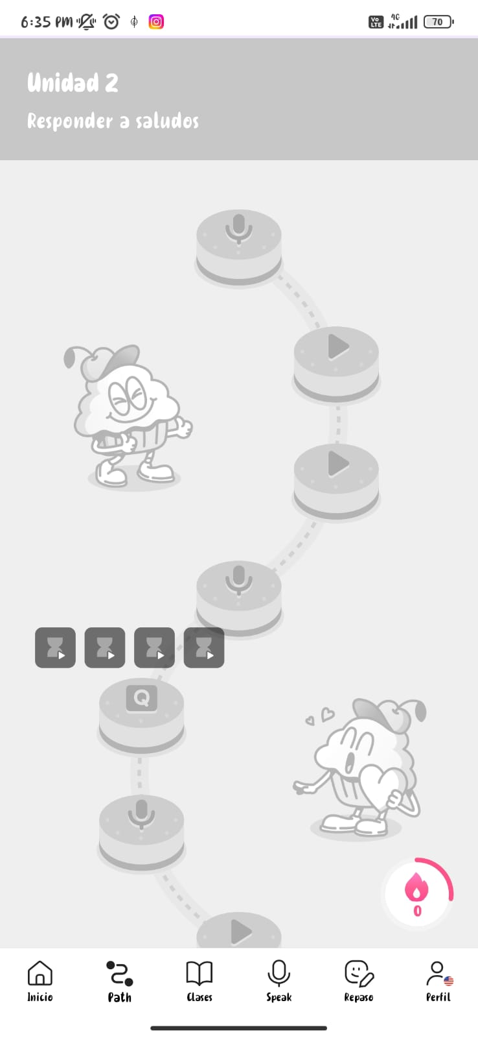
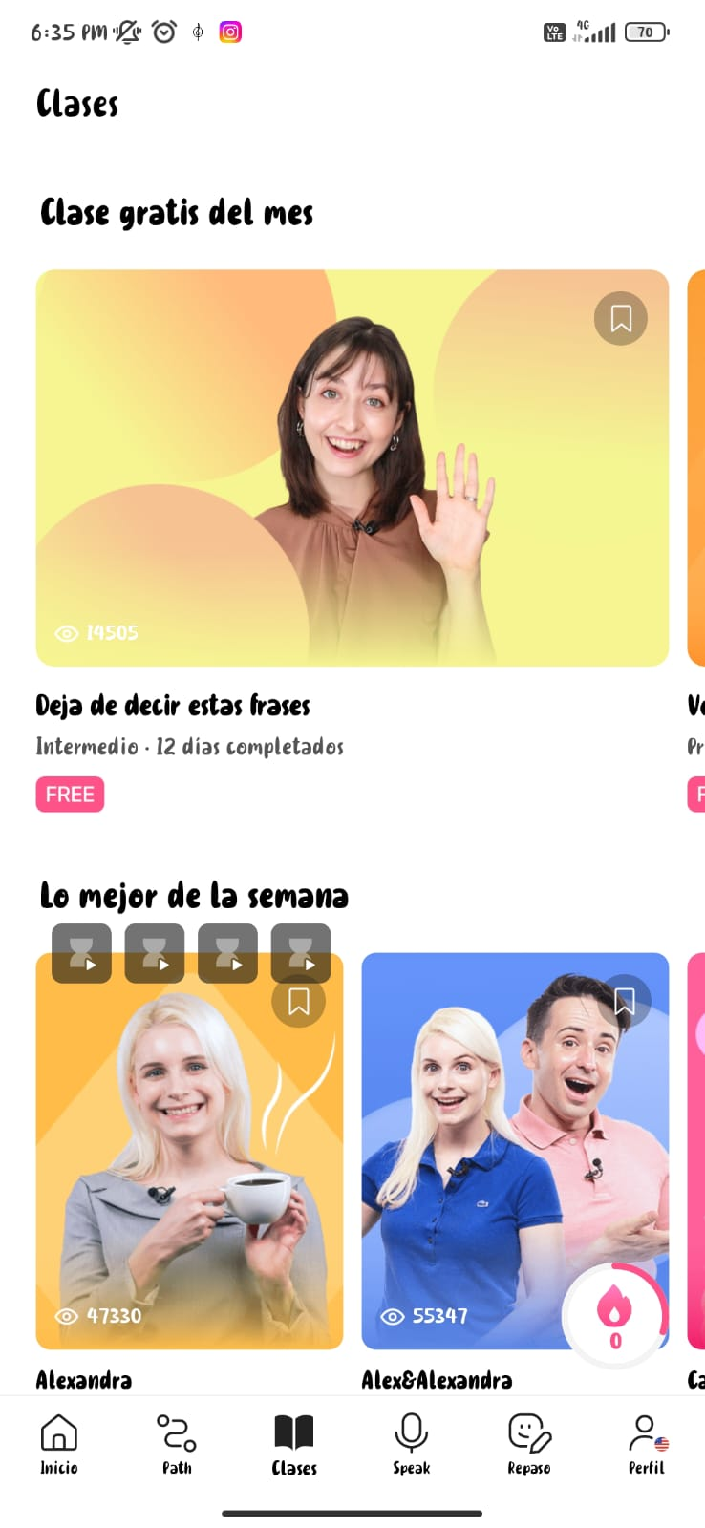
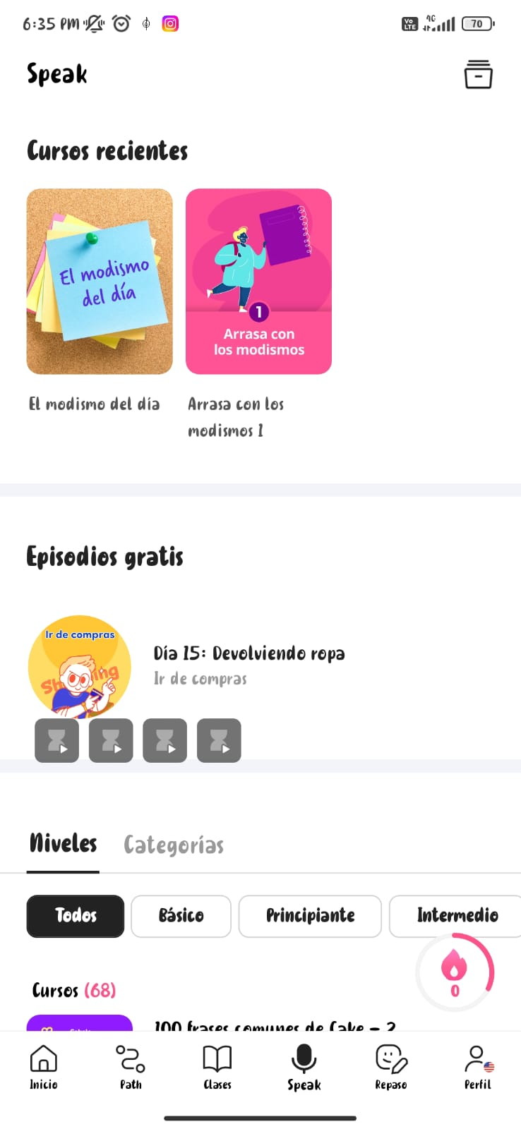
APPS FOR LEARNING ENGLISH

Slide 14
APPS FOR LEARNING ENGLISH
https://play.google.com/store/apps/details?id=me.mycake
For enjoying the app is necessary
Internet
Email account (Gmail for getting in Play store)
Stay with an adult while you play in the app

Slide 15
APPS FOR LEARNING ENGLISH
BÁSICA PRIMARIA | BÁSICA SECUNDARIA | EDUCACIÓN MEDIA
X
App presents different vocabulary categories.
Each category has four tools: learn, writing, find the word, find the picture.
English for kinds is amazing because of different flashcards that improve English learning in kids.

Slide 16
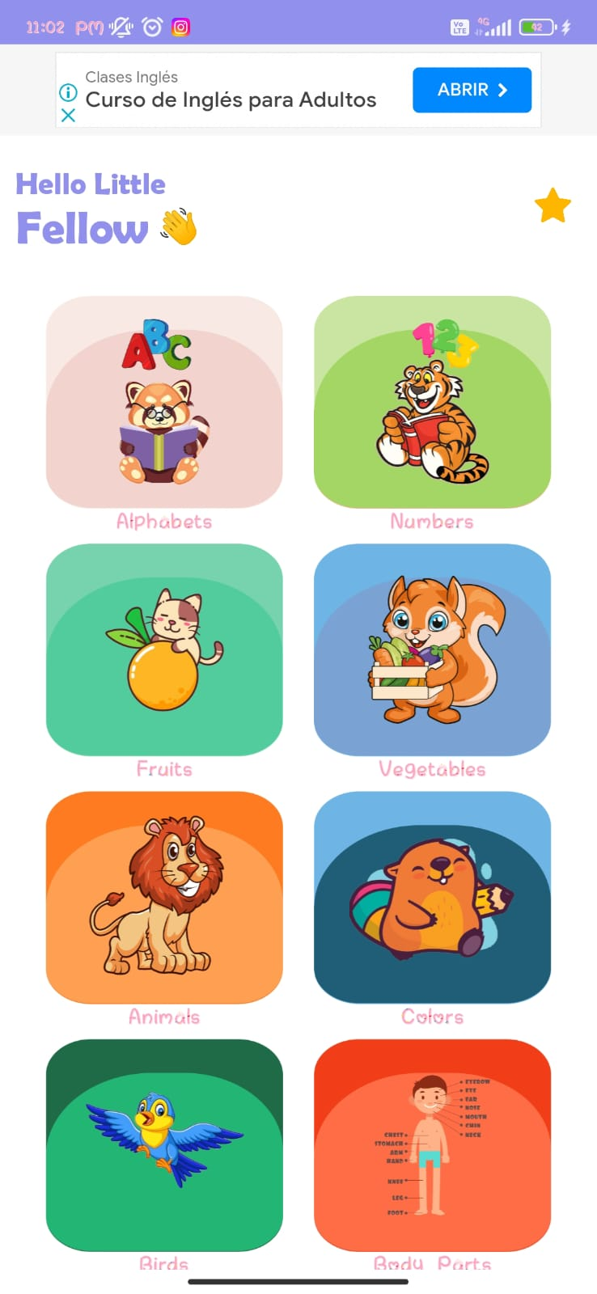
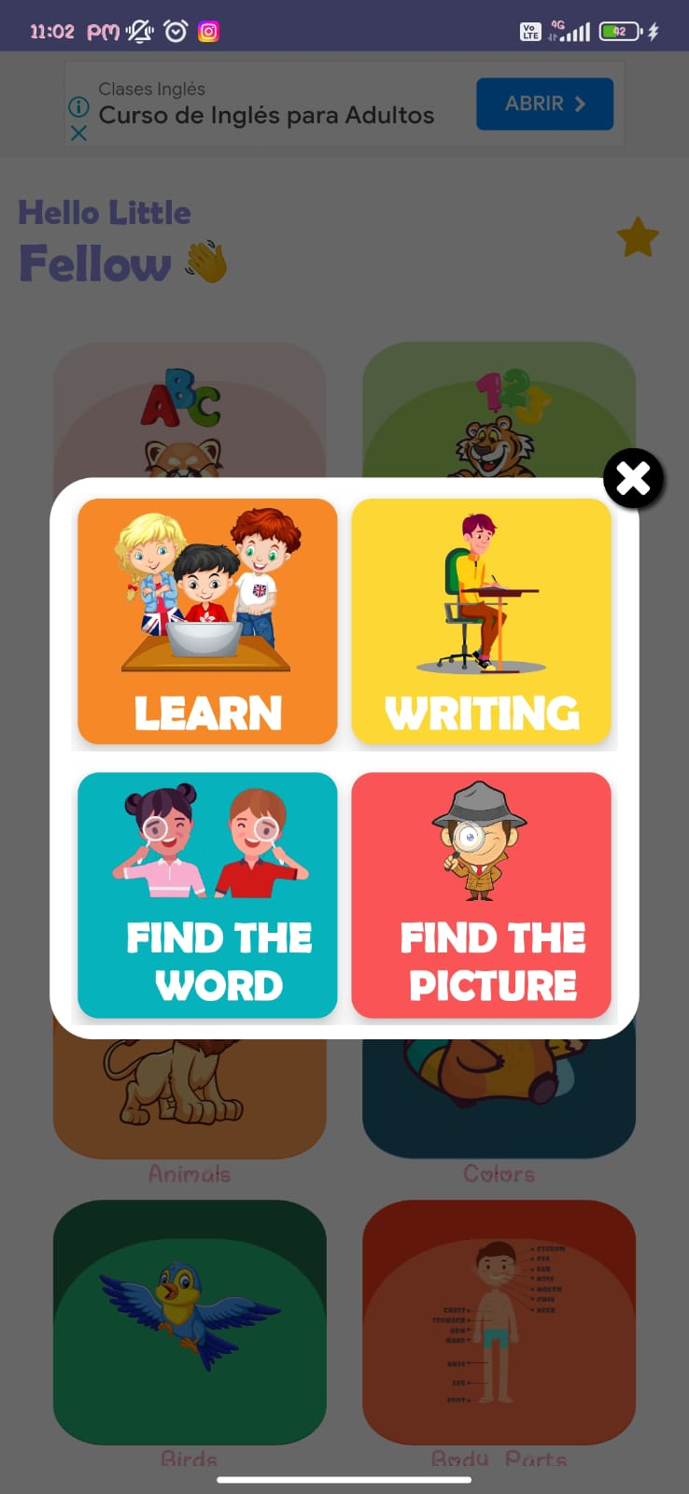
APPS FOR LEARNING ENGLISH

Slide 17
APPS FOR LEARNING ENGLISH
https://play.google.com/store/apps/details?id=com.daimajia.androidanimations.library
For enjoying the app is necessary
Internet
Email account (Gmail for getting in Play store)
Stay with an adult while you play in the app

Slide 18
Create Gmail account
APPS FOR LEARNING ENGLISH
Get in
Select
- Create account
- Write your name
Create an user name
Get in and create a password
Follow steps.

Slide 19
APPS FOR LEARNING ENGLISH
BÁSICA PRIMARIA | BÁSICA SECUNDARIA | EDUCACIÓN MEDIA
X | X | X
Page presents workshops for developing according to the topic.
Workshops can be printable or they can be developed on line.

Slide 20
APPS FOR LEARNING ENGLISH
Teacher can take advantage of that material, depending of the topic that was teaching.
People can develop activities like a self-study or like a task.

Slide 21
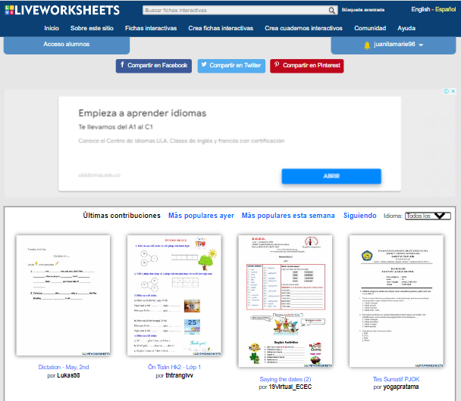
APPS FOR LEARNING ENGLISH

Slide 22
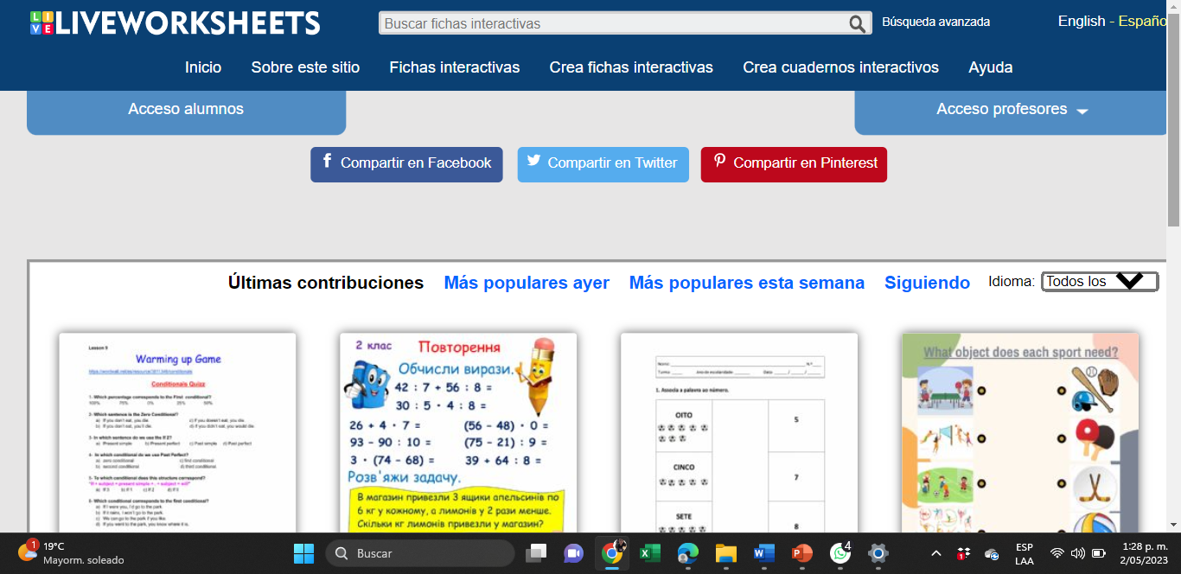
Create your user for enjoying the page
APPS FOR LEARNING ENGLISH

Slide 23
APPS FOR LEARNING ENGLISH
https://es.liveworksheets.com/
For enjoying the app is necessary
Internet
Teacher have to create an user for asking for activities.
Stay with an adult while you play in the page

Slide 24
APPS FOR LEARNING ENGLISH
BÁSICA PRIMARIA | BÁSICA SECUNDARIA | EDUCACIÓN MEDIA
x
Page presents different subjects for learning.
Students can select activities according the age.
In English space students can learn different topics through games.

Slide 25
APPS FOR LEARNING ENGLISH

Slide 26
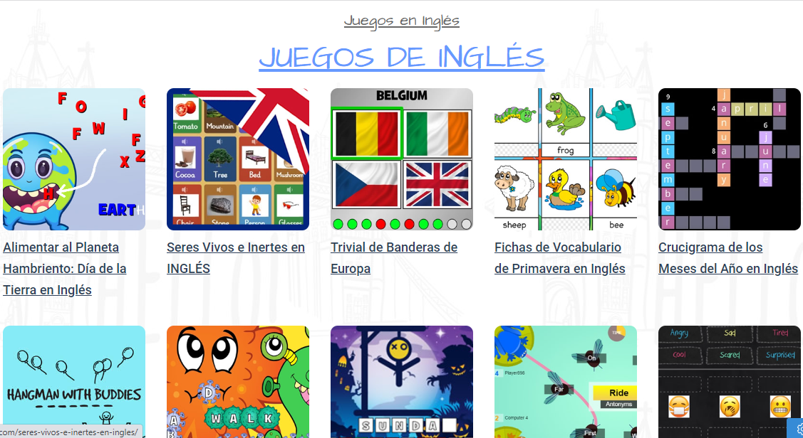
APPS FOR LEARNING ENGLISH

Slide 27
APPS FOR LEARNING ENGLISH
https://www.cokitos.com/tag/juegos-de-ingles/
For enjoying the app is necessary
Internet
Stay with an adult while you play in the page

Slide 28
APPS FOR LEARNING ENGLISH

